Slide 1
Flipping the Supply Chain for a more Sustainable Future
Sydney badger
founder, public habit & Ex-amazon executive

Slide 2
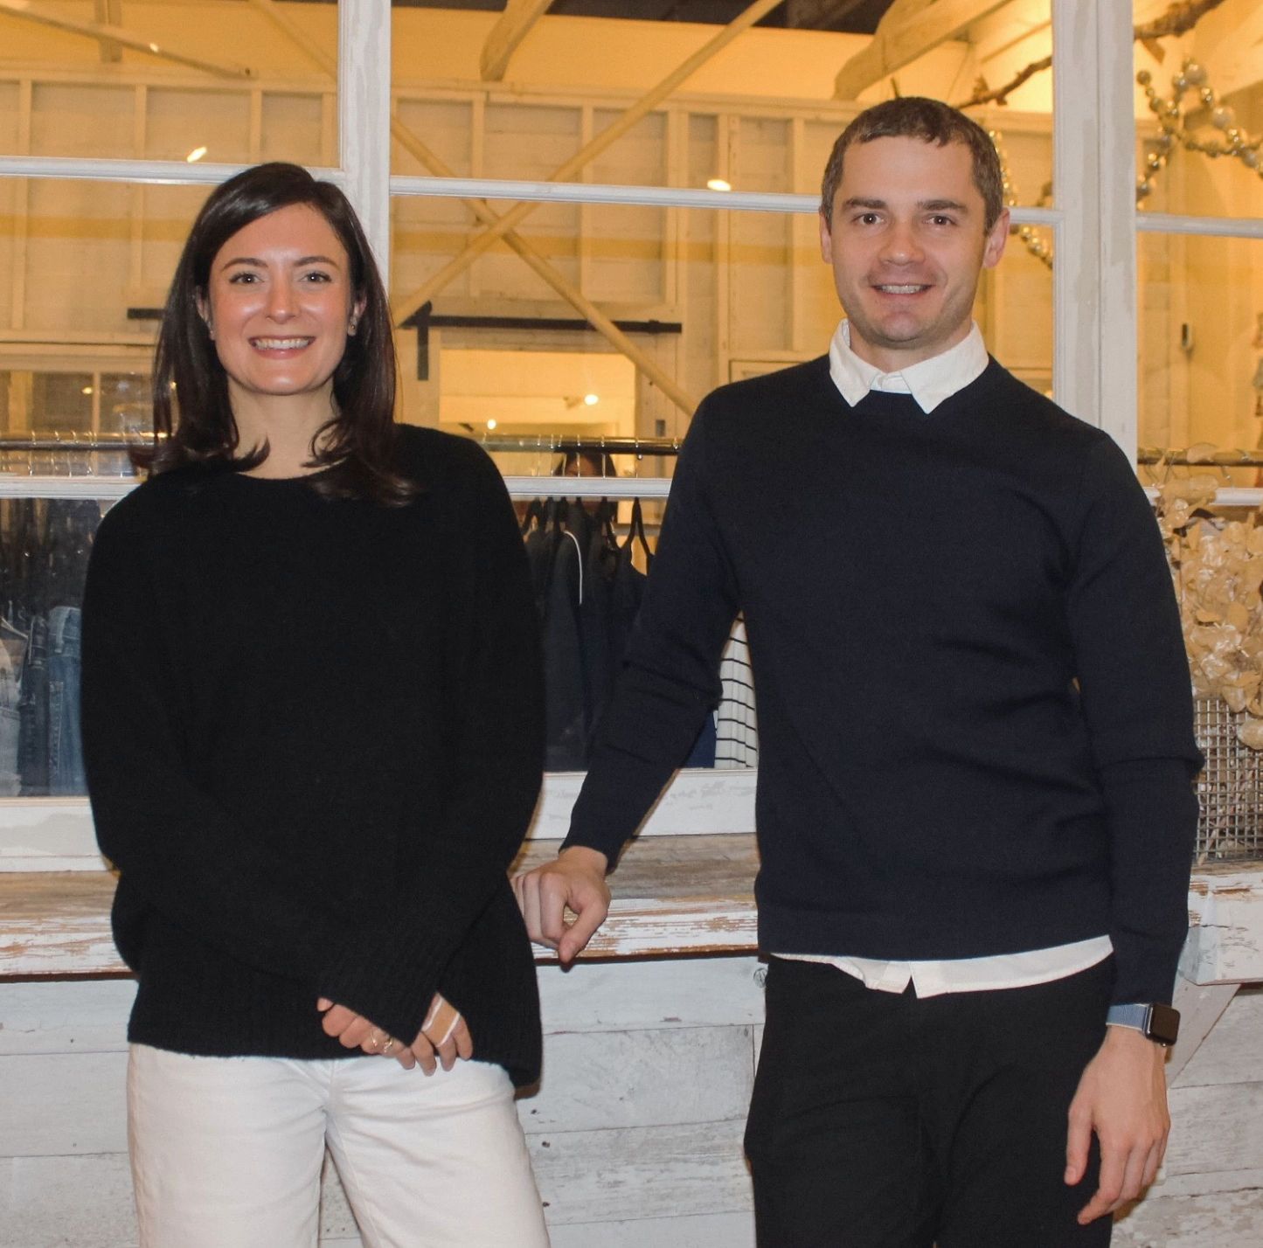
About Me
10+ years in fashion merchandising and operations planning between Amazon.com and Ralph Lauren
5+ years in global apparel & textile sourcing
2+ years as Co-founder of Public Habit, on-demand fashion e-commerce platform
Business proficient in Mandarin
Location: Shenzhen, China // Seattle, WA

Slide 3
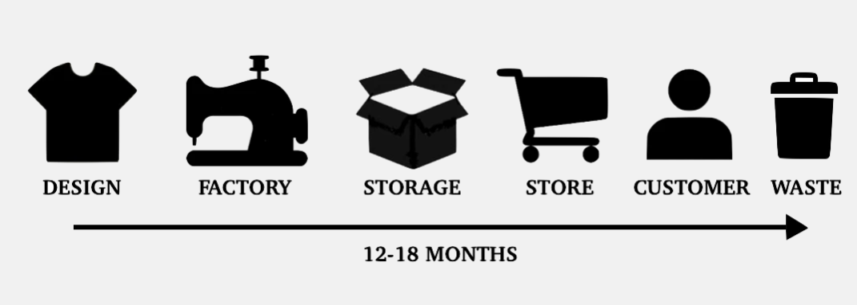
The Fashion Supply Chain is Broken
A slow, linear, analog system for a digital consumer.
Notes:
It’s inefficient, long, and complex…
… Which makes it risky and hard to manage.
Overproduction is a common problem in fashion because of long, complex and inflexible supply chains. Typical brands guess what customers will want at least a year before the customer has a chance to weigh in.

Slide 4
30% of garments made are never sold. That’s over 50 billion garments per year.
Source: Australian Circular Textile Association (ACTA)
Notes:
Brands and retailers have been incinerating tons of unsold clothing every year to protect brand image. Burberry famously burned $36.5M of unsold clothing in 2017, H&M published that they had $4.3B unsold inventory in

Slide 5
A Recipe for Financial AND Environmental Disaster
Bad for THE Bottom Line
Bad for the Environment
Lowest-cost, high-volume sourcing leads to overproduction, increased markdowns and liquidations. Margins decline from 60-80% to 8-10% Long lead times mean that brands have to guess customer demand 6-12+ months in advance. Estimated $210 billion in lost value from overstocks and missed sales.
Over 100 million tons of textile waste produced each year.
Textile industry produces 1.2B tons of greenhouse gas emissions annually.
Cheap garments produced in lowest-cost sourcing regions last fewer wears and are disposed of after fewer than 10 uses.
Over 50% of fast fashion is disposed of within 1 year.
Notes:
In the 20th century, during the industrial age, the only importance was given to the commodity that was transferred along the supply/value chain. But as the industry scaled up, the retailers’ warehouses were buried under garments that nobody needed because nobody ordered them.
By some estimates, up to 30% of market value is lost through inventory inefficiencies. Having too much of the wrong stuff at the wrong time. Or too little of the right stuff.

Slide 6
The Future Supply Chain Needs To Be Demand Driven
Digitally Designed
Cut down development time and sampling waste
Sourced
Identify the right suppliers who can produce in real-time with low MOQs
Digitally Fitted
Embrace 3D fit technology to improve garment fit and lower return rates
Sold
Produced
Adopt more flexible, real-time supply chains.
Lower inventory risk by selling before you produce.
Notes:
An on-demand supply chain is the only sustainable way forward.
We need to bring design, sourcing, fitting, sales and subsequent on-demand manufacturing into the single digital platform-based flow.
Reduces overproduction, therefore minimizing waste
Reduces return rates by getting sizing more accurate before production.
Reduce upfront investments in fabric /finished goods.
The dialog is shifting and sustainability is becoming more and more important to consumers.

Slide 7
Notes:
Low-to-no inventory model

Slide 8
Public Habit 2.0: Virtual Design & Sampling
Source: Voor3d.com | Virtual Showroom and Design platform
Notes:
The dialog is shifting and sustainability is becoming more and more important to consumers.
Reduce samples, travel, time during development processes
Traditional methods of garment manufacturing for pants create approximately 15% cutting waste. So when you use 10,000 yards, at least 1,000 yards of that are destined for landfills in the form of cutting waste. This got us thinking. We use so many precious resources to create fabric that wasting at least 10%, even before garments are made, seems insane.
A bra: A customer wears a sports bra with sensors and a Bluetooth chip sewn in—and the exact size and shape of her body is translated into a custom bra that fits perfectly.

Slide 9
Public Habit 2.0: Localize Production for Global Customers
Reduce carbon footprint by localizing production to where customers are.
Source materials locally to production hubs.
Serve global customers with local supply chains.
Source: denimunspun.com | 3D Design & Manufacturing platform
Notes:
The domestically produced, on-demand model generates less than 1% of the CO2 emissions than the internationally produced product.

Slide 10
Conclusion
Move away from lowest-cost, high-volume sourcing model. Embrace low-to-no inventory model.
Rethink manufacturing relationships from transactional mindset to long-term, partnership mindset where both sides are incentivized the same way.
Bring the consumer along the journey. Educate and be transparent about the changes you are making and why.
Adopt a more agile supply chain built on mutually beneficial, long-term supplier partnerships

Slide 11
“Incremental material changes are not what the world needs. The world needs us to completely upend the way that we do things, to change the whole process and model, to forget what’s been done before.”

Slide 12
Thank You!
Stay in touch : Sydney@publichabit.com | publichabit.com | @publichabit

